Slide 1
Used Car Price Prediction
Course: MA5790
Vaishnavi JANGILI
SAHITHI BATHINI

Slide 2
Problem Statement
Pricing analytics are critical in the automobile industry for both firms and people to determine the market price of a vehicle before selling or purchasing it. Furthermore, used car sales are expanding at an exponential rate.
Because of the demand, car sellers can take advantage of this position by listing exaggerated prices.
As a result, there is a need for a model that can assign a price to a vehicle based on its attributes and the costs of competing cars.

Slide 3
Data Description
Data gathering
The dataset contains 8128 records of cars
It contains 13 attributes with the target variable describing the selling price of a particular car.
Data source
The dataset is an open-source dataset found on Kaggle.
https://www.kaggle.com/datasets/avikasliwal/used-cars-price-prediction
Features | Data
Name | Categorical
Year | Continuous
Km_driven | Continuous
fuel_type | Categorical
seller_type | Categorical
transmission | Categorical
owner | Categorical
mileage | Continuous
enginee_cc | Continuous
max_power | Continuous
seats | Continuous
torque | Continuous
selling_price | Continuous

Slide 4
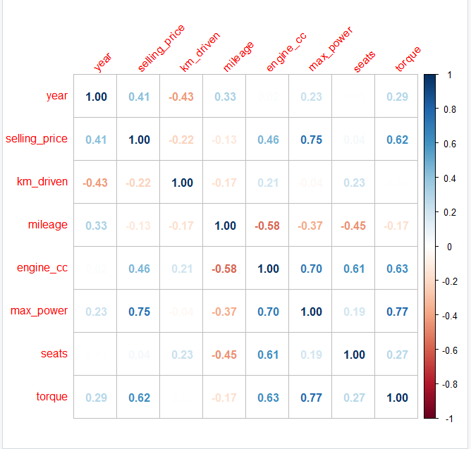
Correlation Plot

Slide 5
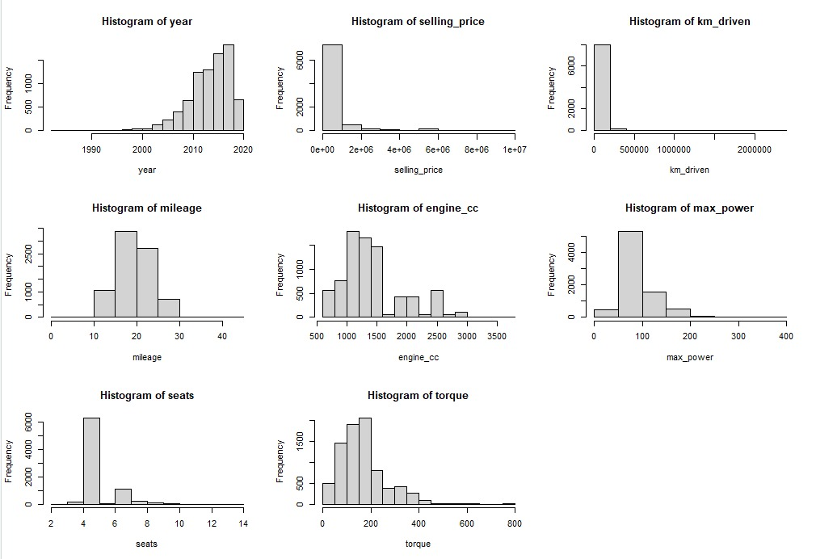
Distribution Of Continuous Variables.

Slide 6
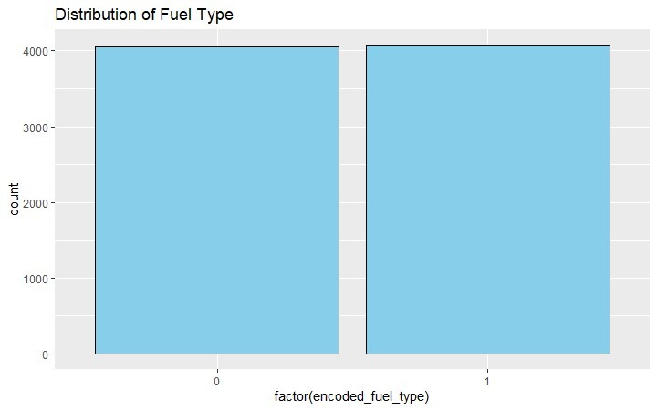
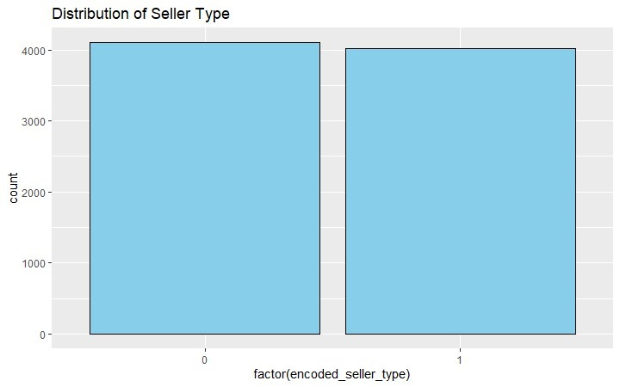
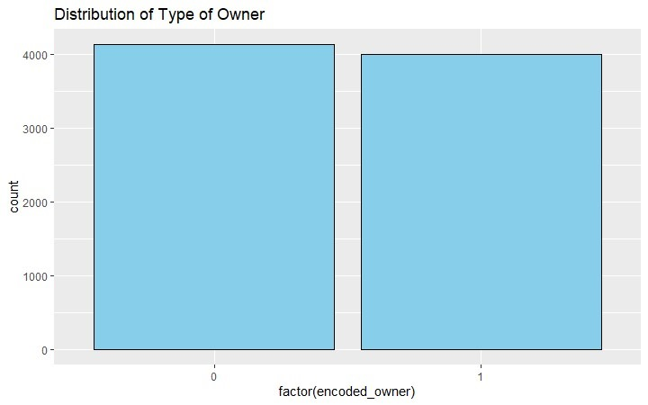
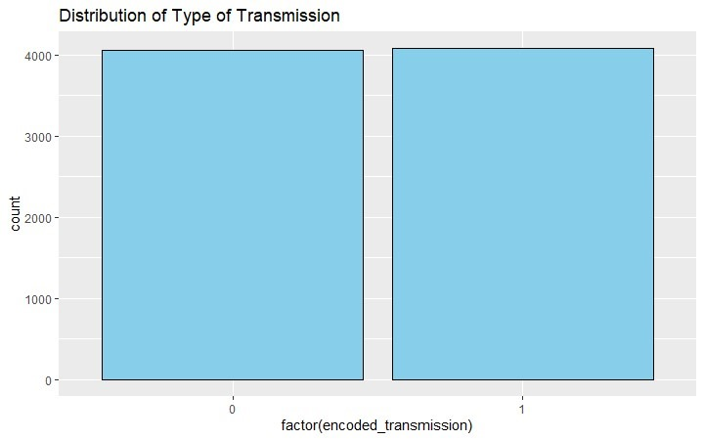
Distribution Of Categorical Variables.

Slide 7
Pre Processing Data
Dealing with Missing values:
The na. omit() function is used to remove missing values (NA or Nan) from the data frame.
Dummy Variables:
To represent categorical data numerically we created dummy variables for all the categorical variables. numerically

Slide 8
Near Zero Variables:
These variables may not provide much information and can be candidates for removal from the dataset.
fuel_typeCNG
fuel_typeLPG
seller_typeTrustmarkdealer
ownerFour/above
ownerTest
Highly Correlated Variables:
To enhance model interpretability and prevent multicollinearity, highly correlated variables
After Pre-processing the data, the sample size is 7906 and there are 12 predictors in the data frame.

Slide 9
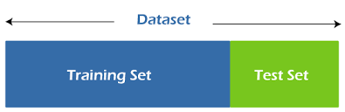
Spending of Data
Training Set (80%): Comprises 80% of the dataset and Used for training and building our models.
Testing Set (20%): Represents the remaining 20% of the data and is reserved for evaluating model performance.
Resampling
We will utilize a 3-fold cross-validation strategy to assess our models.
The dataset is divided into three subsets or "folds."

Slide 10
Linear Continuous Models:
Linear Regression
Ridge Regression
LASSO
Elastic Net Model
Non-Linear Continuous Model:
Neural Network
SVM
KNN
MARS

Slide 11
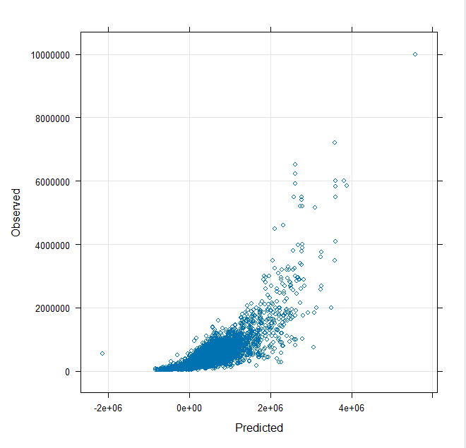
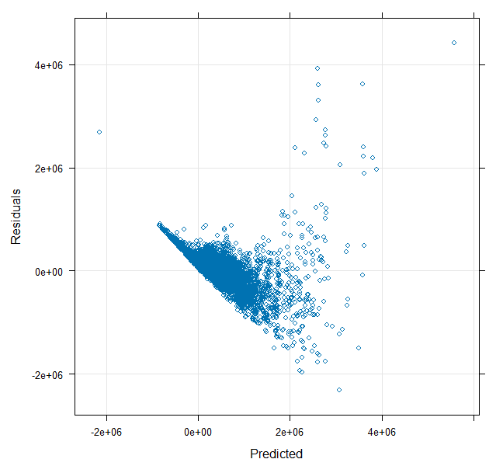
Linear Regression
6327 samples
12 predictor
No pre-processing
Resampling: Cross-Validated (3 fold)
Summary of sample sizes: 4218, 4217, 4219
Resampling results:
RMSE Rsquared MAE
469908.5 0.668314 278638.7
Tuning parameter 'intercept' was held constant at a value of TRUE

Slide 12
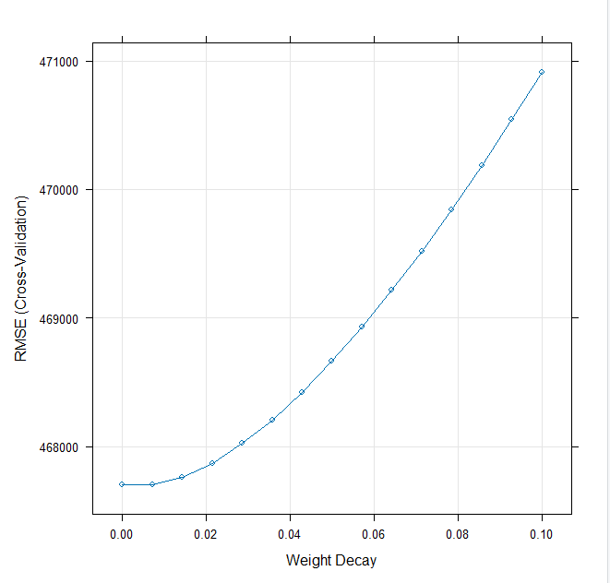
Ridge Regression
6327 samples
12 predictor
Pre-processing: centered (12), scaled (12)
Resampling: Cross-Validated (3 fold)
Summary of sample sizes: 4218, 4217, 4219
Resampling results across tuning parameters:
lambda RMSE Rsquared MAE
0.000000000 467702.6 0.6723565 277594.5
0.007142857 467700.0 0.6723782 277875.8
0.014285714 467760.6 0.6723301 278231.2
0.021428571 467871.4 0.6722318 278684.6
0.028571429 468023.0 0.6720968 279193.1
0.035714286 468209.0 0.6719351 279746.8
0.042857143 468424.4 0.6717539 280332.7
0.050000000 468665.8 0.6715584 280959.1
0.057142857 468930.3 0.6713525 281610.4
0.064285714 469216.0 0.6711393 282283.6
0.071428571 469521.1 0.6709209 282977.4
0.078571429 469844.4 0.6706992 283702.1
0.085714286 470184.9 0.6704755 284468.9
0.092857143 470541.7 0.6702508 285261.3
0.100000000 470914.1 0.6700259 286076.6
RMSE was used to select the optimal model using the smallest value.
The final value used for the model was lambda = 0.007142857.

Slide 13
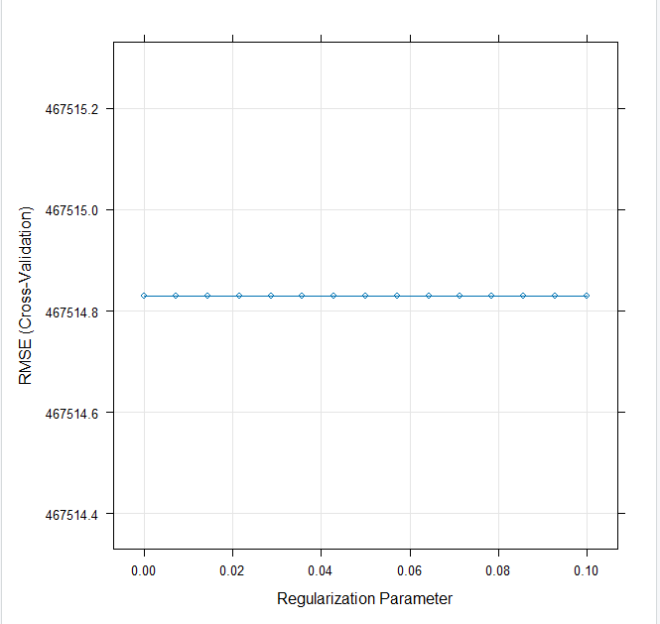
LASSO
6327 samples
12 predictor
Pre-processing: centered (12), scaled (12)
Resampling: Cross-Validated (3 fold)
Summary of sample sizes: 4218, 4219, 4217
Resampling results across tuning parameters:
lambda RMSE Rsquared MAE
0.000000000 467514.8 0.6712203 276882.5
0.007142857 467514.8 0.6712203 276882.5
0.014285714 467514.8 0.6712203 276882.5
0.021428571 467514.8 0.6712203 276882.5
0.028571429 467514.8 0.6712203 276882.5
0.035714286 467514.8 0.6712203 276882.5
0.042857143 467514.8 0.6712203 276882.5
0.050000000 467514.8 0.6712203 276882.5
0.057142857 467514.8 0.6712203 276882.5
0.064285714 467514.8 0.6712203 276882.5
0.071428571 467514.8 0.6712203 276882.5
0.078571429 467514.8 0.6712203 276882.5
0.085714286 467514.8 0.6712203 276882.5
0.092857143 467514.8 0.6712203 276882.5
0.100000000 467514.8 0.6712203 276882.5
Tuning parameter 'alpha' was held constant at a value of 1
RMSE was used to select the optimal model using the smallest value.
The final values used for the model were alpha = 1 and lambda = 0.1.

Slide 14
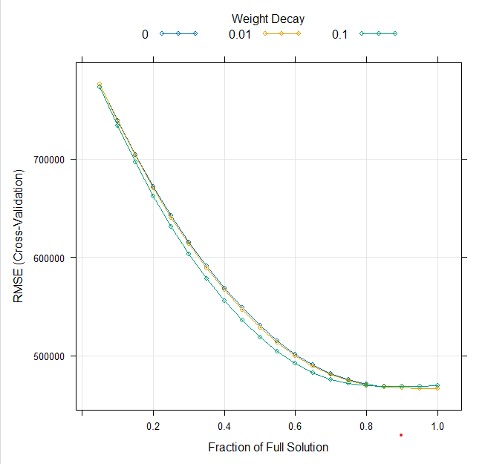
Elasticnet
6327 samples
12 predictor
Pre-processing: centered (12), scaled (12)
Resampling: Cross-Validated (3 fold)
Summary of sample sizes: 4220, 4217, 4217
Resampling results across tuning parameters:
lambda fraction RMSE Rsquared MAE
0.00 0.05 776131.9 0.5611088 401188.2
0.00 0.10 739307.8 0.5611088 377708.1
0.00 0.15 704473.3 0.5611088 356025.1
0.00 0.20 671937.9 0.5611088 336175.6
0.00 0.25 642051.0 0.5611088 318347.2
0.00 0.30 615143.3 0.5725559 303539.4
0.00 0.35 590641.4 0.5876422 291712.8
0.00 0.40 568629.9 0.6063973 278948.7
0.00 0.45 548491.9 0.6236167 268657.8
0.00 0.50 530491.0 0.6356258 261676.9
0.00 0.55 514943.6 0.6445443 257104.2
0.00 0.60 501509.5 0.6522863 254969.2
0.00 0.65 490494.0 0.6582256 254969.3
0.00 0.70 481888.7 0.6624881 257158.3
0.00 0.75 475468.9 0.6658322 260722.6
0.00 0.80 471051.4 0.6688484 264261.4
0.00 0.85 468272.0 0.6709643 268295.6
0.00 0.90 467093.3 0.6717331 272317.6
0.00 0.95 466493.7 0.6723535 274709.9
0.00 1.00 466418.0 0.6724095 277173.5
0.01 0.05 775695.3 0.5611088 400905.4
0.01 0.10 738478.4 0.5611088 377181.4
0.01 0.15 703305.5 0.5611088 355298.9
0.01 0.20 670498.1 0.5611088 335294.9
0.01 0.25 640420.0 0.5611088 317400.4
0.01 0.30 613361.8 0.5751574 302566.4
0.01 0.35 588785.0 0.5897446 290830.5
0.01 0.40 566683.5 0.6088883 277910.9
0.01 0.45 546517.0 0.6255482 267849.6
0.01 0.50 528583.8 0.6371656 261038.1
0.01 0.55 513125.0 0.6458864 256680.5
0.01 0.60 499882.7 0.6535142 254499.0
0.01 0.65 489075.1 0.6593253 254415.8
0.01 0.70 480722.6 0.6633393 256900.8
0.01 0.75 474589.9 0.6664319 260845.6
0.01 0.80 470492.6 0.6691062 264760.6
0.01 0.85 467962.2 0.6710706 269117.1
0.01 0.90 466943.6 0.6718677 272630.1
0.01 0.95 466387.4 0.6725097 275044.3
0.01 1.00 466461.1 0.6723997 277633.7
0.10 0.05 773084.6 0.5611088 399223.9
0.10 0.10 733530.7 0.5611088 374065.9
0.10 0.15 696361.7 0.5611088 350999.6
0.10 0.20 661979.4 0.5611088 330114.9
0.10 0.25 631021.9 0.5726133 311959.3
0.10 0.30 603071.0 0.5893611 297691.3
0.10 0.35 578102.7 0.6019747 285987.6
0.10 0.40 555731.7 0.6217776 272304.9
0.10 0.45 535897.2 0.6351480 262682.9
0.10 0.50 518747.0 0.6446823 255812.0
0.10 0.55 504023.6 0.6526391 251746.4
0.10 0.60 491863.0 0.6583216 251065.7
0.10 0.65 482504.5 0.6622969 253497.3
0.10 0.70 475819.7 0.6651293 257977.8
0.10 0.75 471678.3 0.6669227 264193.0
0.10 0.80 469834.1 0.6678885 271425.5
0.10 0.85 469004.0 0.6690116 274736.8
0.10 0.90 468567.1 0.6700235 278174.4
0.10 0.95 468860.9 0.6703858 282143.8
0.10 1.00 469745.6 0.6699945 285742.9
RMSE was used to select the optimal model using the smallest value.
The final values used for the model were fraction = 0.95 and lambda = 0.01.

Slide 15
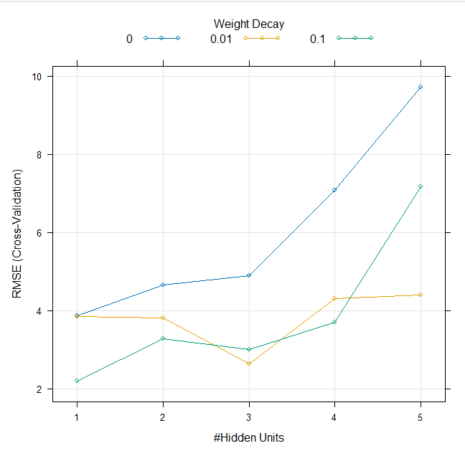
Model Averaged Neural Network
6324 samples
12 predictor
Pre-processing: centered (12), scaled (12)
Resampling: Cross-Validated (3 fold)
Summary of sample sizes: 4215, 4217, 4216
Resampling results across tuning parameters:
decay size RMSE Rsquared MAE
0.00 1 3.865545 0.27332434 2.842996
0.00 2 4.658231 0.12623854 2.402715
0.00 3 4.893775 0.13336841 2.798459
0.00 4 7.071085 0.02307819 3.145179
0.00 5 9.722237 0.08623998 3.411793
0.01 1 3.851940 0.44222982 1.957639
0.01 2 3.806689 0.33759991 2.031443
0.01 3 2.643523 0.60679700 1.943071
0.01 4 4.300895 0.24709172 2.169208
0.01 5 4.403447 0.45606960 2.129311
0.10 1 2.196803 0.69361172 1.697985
0.10 2 3.279500 0.42812852 1.805088
0.10 3 3.013028 0.53789909 1.686899
0.10 4 3.701389 0.41648122 2.321675
0.10 5 7.170474 0.21231229 2.321623
Tuning parameter 'bag' was held constant at a value of FALSE
RMSE was used to select the optimal model using the smallest value.
The final values used for the model were size = 1, decay = 0.1 and bag = FALSE.

Slide 16
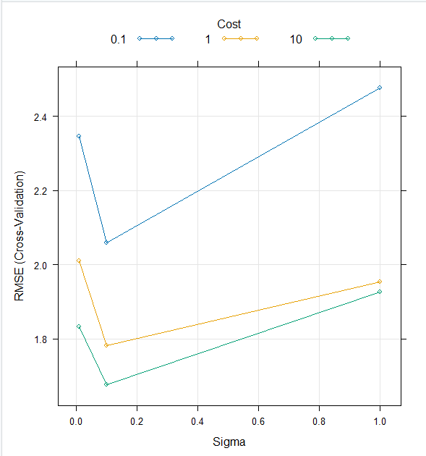
Support Vector Machines with Radial Basis Function Kernel
Support Vector Machines with Radial Basis Function Kernel
6324 samples
12 predictor
Pre-processing: centered (12), scaled (12)
Resampling: Cross-Validated (3 fold)
Summary of sample sizes: 4216, 4217, 4215
Resampling results across tuning parameters:
sigma C RMSE Rsquared MAE
0.01 0.1 2.346562 0.6530590 1.668060
0.01 1.0 2.009671 0.7349252 1.411882
0.01 10.0 1.833261 0.7773609 1.293870
0.10 0.1 2.059668 0.7272994 1.429606
0.10 1.0 1.781731 0.7900126 1.247322
0.10 10.0 1.676611 0.8123967 1.170976
1.00 0.1 2.477357 0.6302580 1.688115
1.00 1.0 1.952976 0.7501514 1.306381
1.00 10.0 1.927270 0.7522538 1.287836
RMSE was used to select the optimal model using the smallest value.
The final values used for the model were sigma = 0.1 and C = 10.

Slide 17
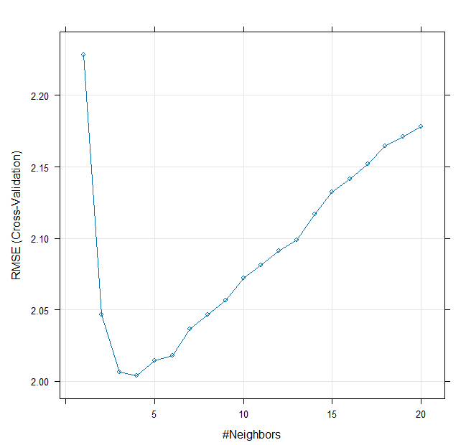
k-Nearest Neighbors
6324 samples
12 predictor
Pre-processing: centered (12), scaled (12)
Resampling: Cross-Validated (3 fold)
Summary of sample sizes: 4217, 4215, 4216
Resampling results across tuning parameters:
k RMSE Rsquared MAE
1 2.228562 0.6880460 1.403241
2 2.046423 0.7249704 1.374554
3 2.006494 0.7327000 1.368904
4 2.003764 0.7324919 1.369141
5 2.014637 0.7292590 1.383353
6 2.018082 0.7282268 1.397011
7 2.036774 0.7231561 1.412206
8 2.046629 0.7204254 1.422921
9 2.056740 0.7175508 1.432748
10 2.072414 0.7132423 1.445045
11 2.081393 0.7109269 1.454489
12 2.091126 0.7083600 1.462621
13 2.098923 0.7062235 1.472064
14 2.117024 0.7012699 1.483421
15 2.132690 0.6969176 1.495752
16 2.141633 0.6945420 1.505358
17 2.152042 0.6918124 1.515053
18 2.164468 0.6883368 1.525829
19 2.171255 0.6865248 1.536708
20 2.178223 0.6846587 1.542056
RMSE was used to select the optimal model using the smallest value.
The final value used for the model was k = 4.

Slide 18
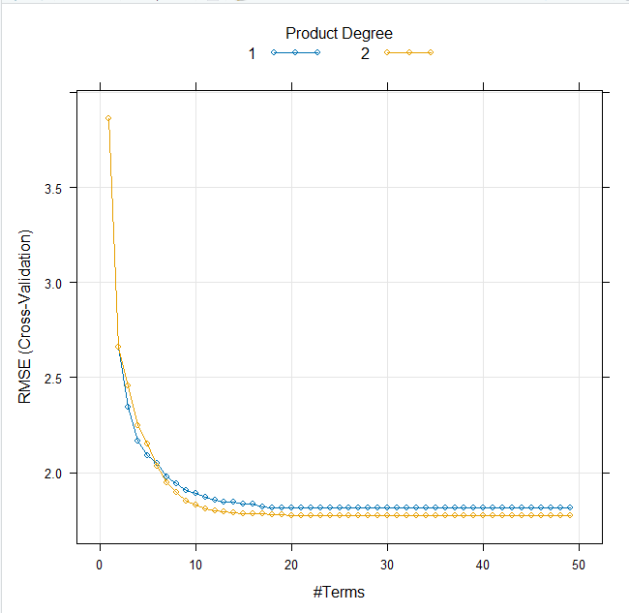
Multivariate Adaptive Regression Spline
6324 samples
12 predictor
No pre-processing
Resampling: Cross-Validated (3 fold)
Summary of sample sizes: 4215, 4217, 4216
Resampling results across tuning parameters:
degree nprune RMSE Rsquared MAE
1 1 3.863911 NaN 3.083198
1 2 2.661849 0.5248413 2.103586
1 3 2.346003 0.6292699 1.793385
1 4 2.167459 0.6842370 1.644808
1 5 2.088861 0.7074938 1.571462
1 6 2.048238 0.7183822 1.545083
1 7 1.976409 0.7381426 1.472102
1 8 1.943067 0.7465795 1.444690
1 9 1.907595 0.7557827 1.413604
1 10 1.888578 0.7606871 1.399346
1 11 1.869412 0.7654319 1.370352
1 12 1.855742 0.7688159 1.360951
1 13 1.846486 0.7711014 1.349563
1 14 1.844220 0.7716869 1.348217
1 15 1.834923 0.7740308 1.344149
1 16 1.834969 0.7740762 1.340624
1 17 1.819560 0.7779153 1.332907
1 18 1.816614 0.7784945 1.327643
1 19 1.812884 0.7794705 1.323816
1 20 1.812622 0.7795310 1.324114
1 21 1.812622 0.7795310 1.324114
1 22 1.812622 0.7795310 1.324114
1 23 1.812622 0.7795310 1.324114
1 24 1.812622 0.7795310 1.324114
1 25 1.812622 0.7795310 1.324114
1 26 1.812622 0.7795310 1.324114
1 27 1.812622 0.7795310 1.324114
1 28 1.812622 0.7795310 1.324114
1 29 1.812622 0.7795310 1.324114
1 30 1.812622 0.7795310 1.324114
1 31 1.812622 0.7795310 1.324114
1 32 1.812622 0.7795310 1.324114
1 33 1.812622 0.7795310 1.324114
1 34 1.812622 0.7795310 1.324114
1 35 1.812622 0.7795310 1.324114
1 36 1.812622 0.7795310 1.324114
1 37 1.812622 0.7795310 1.324114
1 38 1.812622 0.7795310 1.324114
1 39 1.812622 0.7795310 1.324114
1 40 1.812622 0.7795310 1.324114
1 41 1.812622 0.7795310 1.324114
1 42 1.812622 0.7795310 1.324114
1 43 1.812622 0.7795310 1.324114
1 44 1.812622 0.7795310 1.324114
1 45 1.812622 0.7795310 1.324114
1 46 1.812622 0.7795310 1.324114
1 47 1.812622 0.7795310 1.324114
1 48 1.812622 0.7795310 1.324114
1 49 1.812622 0.7795310 1.324114
2 1 3.863911 NaN 3.083198
2 2 2.661849 0.5248413 2.103586
2 3 2.456539 0.5950874 1.930645
2 4 2.245254 0.6621195 1.727108
2 5 2.148948 0.6908970 1.599703
2 6 2.031869 0.7230820 1.532090
2 7 1.947471 0.7458853 1.452564
2 8 1.893857 0.7596378 1.410169
2 9 1.849005 0.7708457 1.379064
2 10 1.829555 0.7755328 1.365902
2 11 1.808899 0.7805027 1.343401
2 12 1.800703 0.7824762 1.335741
2 13 1.793827 0.7842153 1.327515
2 14 1.787375 0.7857623 1.321402
2 15 1.784924 0.7863727 1.320967
2 16 1.785236 0.7863315 1.320791
2 17 1.785421 0.7862399 1.317519
2 18 1.780859 0.7873512 1.316026
2 19 1.780096 0.7875293 1.316323
2 20 1.774042 0.7890059 1.313411
2 21 1.773290 0.7891873 1.312983
2 22 1.773290 0.7891873 1.312983
2 23 1.773290 0.7891873 1.312983
2 24 1.773290 0.7891873 1.312983
2 25 1.773290 0.7891873 1.312983
2 26 1.773290 0.7891873 1.312983
2 27 1.773290 0.7891873 1.312983
2 28 1.773290 0.7891873 1.312983
2 29 1.773290 0.7891873 1.312983
2 30 1.773290 0.7891873 1.312983
2 31 1.773290 0.7891873 1.312983
2 32 1.773290 0.7891873 1.312983
2 33 1.773290 0.7891873 1.312983
2 34 1.773290 0.7891873 1.312983
2 35 1.773290 0.7891873 1.312983
2 36 1.773290 0.7891873 1.312983
2 37 1.773290 0.7891873 1.312983
2 38 1.773290 0.7891873 1.312983
2 39 1.773290 0.7891873 1.312983
2 40 1.773290 0.7891873 1.312983
2 41 1.773290 0.7891873 1.312983
2 42 1.773290 0.7891873 1.312983
2 43 1.773290 0.7891873 1.312983
2 44 1.773290 0.7891873 1.312983
2 45 1.773290 0.7891873 1.312983
2 46 1.773290 0.7891873 1.312983
2 47 1.773290 0.7891873 1.312983
2 48 1.773290 0.7891873 1.312983
2 49 1.773290 0.7891873 1.312983
RMSE was used to select the optimal model using the smallest value.
The final values used for the model were nprune = 21
and degree = 2.

Slide 19
Linear Continuous Models | Best Tuning Parameter | Training R^2
Linear Model | Intercept = True | 0.668314
Ridge | Lambda = 0.0071 | 0.67237
LASSO | alpha=1, lambda=0.1 | 0.6712203
E NET | fraction = 0.95, lambda = 0.01 | 0.672509
The top 2 best models are :
Elastic Net Model
SVM Model
Non-Linear Continuous Model | Best Tuning Parameter | Training R^2
Neural Network | Size=1, Decay=0.1 | 0.69361
SVM | Sigma = 0.1, C=10 | 0.81239
KNN | k=4 | 0.73249
MARS | Nprune = 21, degree=2 | 0.789187

Slide 20
Prediction on Test Set of Top 2 Models
Below is the prediction on the testing set of the optimal linear continuous model “Elastic Net Model”
RMSE Rsquared MAE
4.591511e+05 6.771068e-01 2.767793e+05
Below is the prediction on the testing set of the optimal non-linear continuous model “MARS”
RMSE Rsquared MAE
1.6432855 0.8167817 1.1551461
The R-squared value of MARS model is relatively higher than that of Elastic net model. Hence, we recommend SVM model as best model.

Slide 21
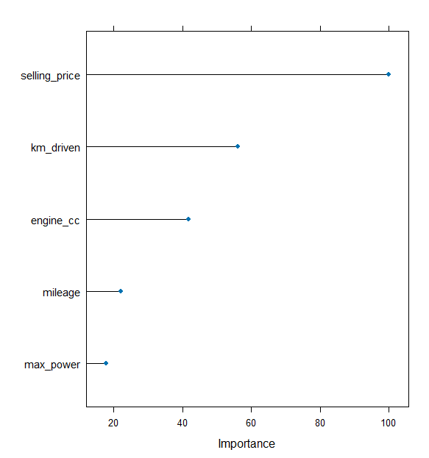
Important Predictors of Best Model (MARS)
earth variable importance
Overall
selling_price 100.00
km_driven 55.97
engine_cc 41.75
mileage 22.09
max_power 17.71
torque 17.71

Slide 22
Thank you…

